Slide 1

Linear Regression using R
Dr. Talari Ganesh
Department of Mathematics & Scientific Computing
NIT Hamirpur (HP)
Email: drganesh@nith.ac.in

Slide 2
Introduction
It is a binary classification algorithm used when the response variable is dichotomous (1 or 0). Inherently, it returns the set of probabilities of target class. But, we can also obtain response labels using a probability threshold value. Following are the assumptions made by Logistic Regression:
The response variable must follow a binomial distribution.
Logistic Regression assumes a linear relationship between the independent variables and the link function (logit).
The dependent variable should have mutually exclusive and exhaustive categories.

Slide 3
Name derived from Logit transformation
Differences from OLS
Used for predicting outcome of a binary dependent variable
That is the Data Visualization has to be nominal restricted to two variables only
Use logit transformation on the DV to fit a linear regression model

Slide 4
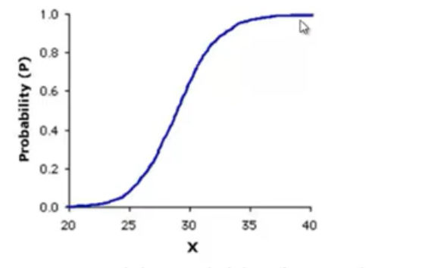
Hours Studied | Results (1=Pass, 0=Fail)
29 | 0
15 | 0
33 | 1
28 | 1
39 | 1
44 | 1
31 | 1
19 | 0
9 | 1
24 | 0
32 | 0
31 | 0
37 | 1
35 | 1
We can study how probability of passing changes as per the hours studies using joint probability distributions
Can we train the regression model on this relationship?

Slide 5
Logistic Regression Concepts
Model the Probability of an event – rather than a measure
Probabilities ranges from 0 to 1 (Min Prob is 0 and Max Prob is 1)
Need to create a dependent variable as a probability range, requires a transformation from the binary nominal variable dataset.
LOGIT transformation used to create the dependent variable, hence named Logistic Rgression
All assumptions of OLS regression are still valid, however deviations are tolerated to a large extent – as end result in most cases require only a rank order.

Slide 6
Logit Odds
Regression models the Log of the odds of an event
Odds or Odds ratio
Odds=P/(1-p)
P – probability of an event happening or
P=Odds/(1+Odds)
Logit Regression equation
Log(Odds)= β₀ +β₁x₁+β₂ x₂+…+β_{p}x_{p}+ error
Similar to regression equation
P ranges from 0 to 1, however Log Odds ranges from –ꝏ to +ꝏ

Slide 7
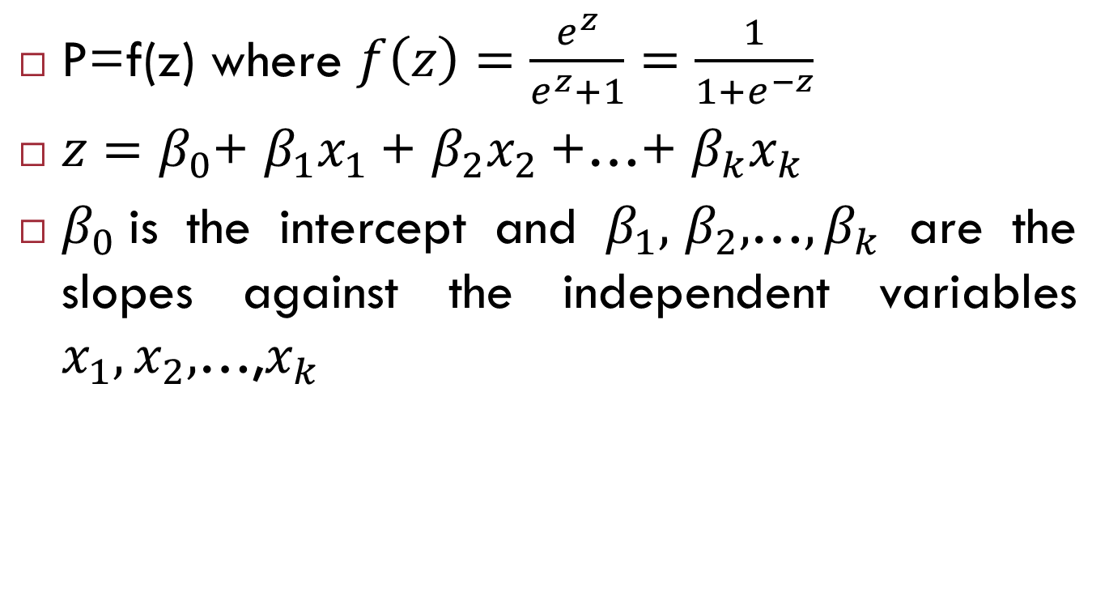
Logit function
P=f(z) where $f\left(z\right)=\frac{e^{z}}{e^{z}+1}=\frac{1}{1+e^{−z}}$
$z=β_{0}$+ $β_{1}x_{1}$+ $β_{2}x_{2}$+…+ $β_{k}x_{k}$
$β_{0}$is the intercept and $β_{1}\text{,} β_{2}\text{,}\text{…},β_{k}$ are the slopes against the independent variables $x_{1},x_{2},$…,$x_{k}$

Slide 8
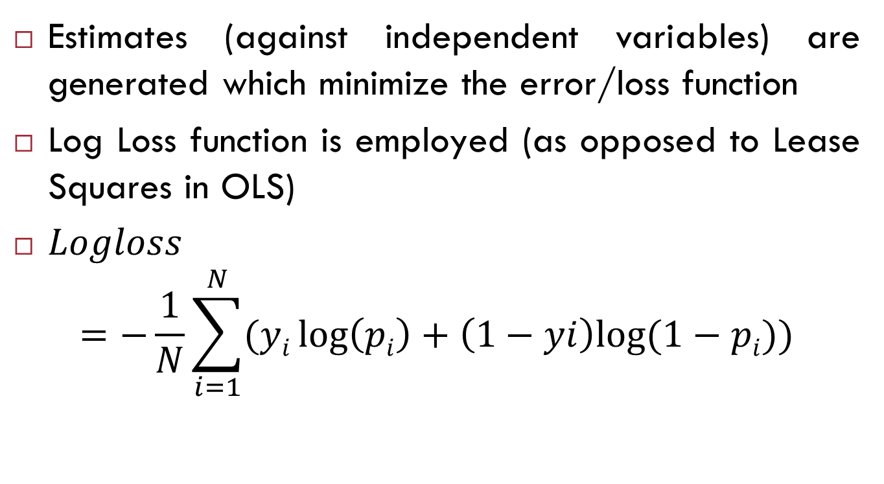
Log Loss function
Estimates (against independent variables) are generated which minimize the error/loss function
Log Loss function is employed (as opposed to Lease Squares in OLS)
$Logloss$
$$=−\frac{1}{N}\sum_{i=1}^{N}{(yi\log\left(pi\right)+\left(1−yi\right)log⁡(1−pi))}$$

Slide 9
For each row in the data set
Y is the outcome (dependent variable) which can be either 0 or 1
P is the predicted probability outcome by applying the logistic regression equation
Adjust the estimates in the logistic regression equation such that the total log loss function over the whole dataset is minimized.
If y is 1 then the function is minimized with high value of p, if y is 0 then the function is minimized with low value of p (since Log(1)=0)

Slide 10


